Slide 1
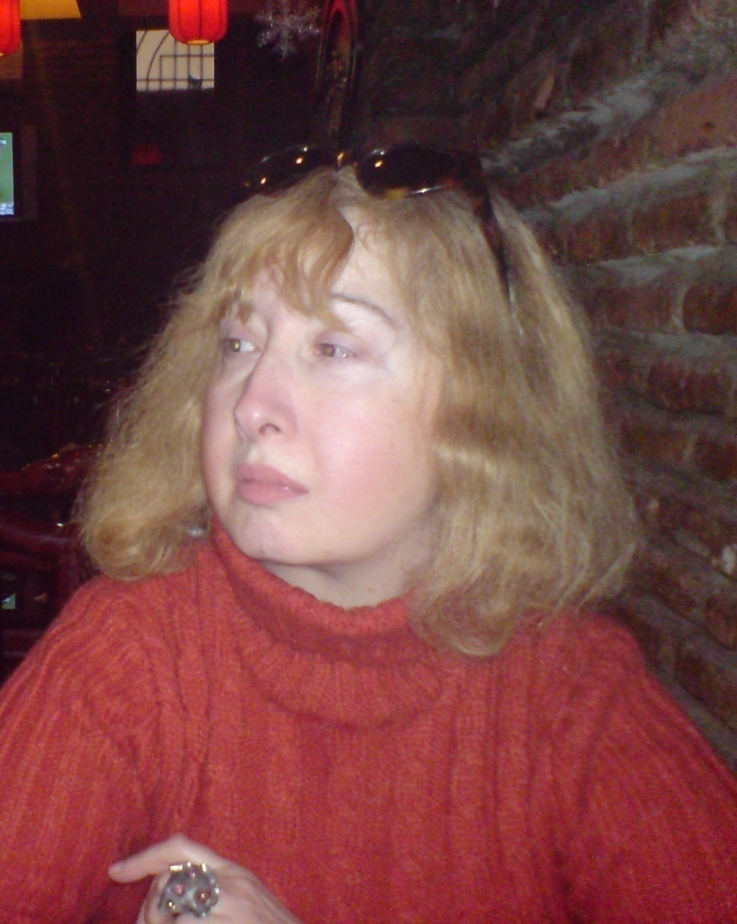
adaptation of psychodrama (J.L Moreno) for Georgian Population and it’s usage for IDPs. 2008-2009 Rusudan Mirtskhulava PHD Psychologist Psychotherapist Professor of Ilia Chavchavadze State University Collaborator of Dimitri Uznadze Institute of Psychology, Tbilisi, Georgia
Abstract Key concepts: Psychodrama, IDP, refugee , bereavement Psychodrama ( and entirely art-therapy) is often used in cases of the psychological work with the IDPs and refugees, who’s psychological condition is densely related to bereavement. The effectiveness of the method must be connected not only with the universal psycho-dramatic techniques, but also with the usage of the ethnic folk elements, corresponding to the distinct culture and country. Current study illuminates the significance of folk elements on the first step of psychodrama (worming up).
Introduction Psychodrama- a therapeutic approach developed by Jacob L. Moreno. Method implies the usage of drama elements and consists of three basic steps: worming up, play and sharing. The major techniques: Mirror techniques, double ego, role exchange. Theoretical basis: Role theory and theory of acting-out(J. L. Moreno). Basic therapeutic factors: Tele(encounter), insight through the action and catharzis. |  |  |  | Research questions Investigation of the significance of Georgian folk elements (songs , dances and plays)on the first step of psychodrama(warming up) and it’s usage for IDPs.
Methods The discription of the research. The research was carried on three groups of IDPs from 20 to 56 years. Totally-180 IDPs; 60 members in each group. First group-During the warming up we have used following methods: 1)Name games. 2)conversation. 3)Folk Georgian songs. 4)Folk Georgian dances 5) Folk Georgian games. Second group:-During the warming up we have used following methods: 1)Name games. 2)Conversation. 3)Classic music(Johann Strauss valses ). 4)Classic dance-valse 5)Circle moving. Third group:-During the warming up we have used following methods: 1)Name games. 2)conversation. The criterion of the method effectiveness: The time of the manifestation concerning protagonist. 2) The numbers of the wishers to be protagonist. 3) The number of the named play themes. 4) The time of play themes manifestation.
 | Results | First group | Second group |  | Third group
 | Time of the protagonist manifestation. | 15-20 minutes | 20-25 minutes |  | 30-35 minutes
 | Number of protagonist wishers. | 20 persons | 8 persons |  | 5 perosns
 | Number of named play themes. | 10 themes | 8 themes |  | 4 themes
 | Time of the mentioned play themes. | 15 -20 minute | 20 minutes |  | 30-35 minutes.
Discussion The maximal effectiveness of the using methods was manifested in group 1. In the case of the utilization of the ethnic folk elements. The minimal effectiveness was manifested in group 3, in which art techniques were not used. Research gives evidence about the positive sense of the folk elements in the structure in the psycodramatic session.
Union Internationale de Psychologie UNIVERSITY OF JENA Workshop on “‘Bereavement Research and Practice Jena, Germany November 1-7, 200 Scientifique

