Slide 2
Social Work Education: International and local Perspective
Shorena Sadzaglishvili, PhD, MSW
Ilia State University
Head of Master and Doctoral Programs in Social Work

Slide 3
Social Work as a Science
Social work as a Professional Practice
Social Work as a Global Profession

Slide 4
Is Social Work a Science? Brekke 2012, 2013; Sommerfeld, 2014; Marsh, 2012; Anastas, 2014; Shaw, 2014; Longhofer and Floersch, 2012.

Slide 5
Social work education has historically been grounded in professional practice
Social work has no unique subject matter or methodology
This profession is made up largely of mater’s level practitioners who as a group do not have the research sophistication that is found among doctoral graduates from other fields.
Social workers have not contributed towards the scientific advances and evidence based treatments relevant to social work as much as other professionals such as psychologists, psychiatrists and sociologists.
The total number of social work journals and the impact factors of these journals indicate that social work’s contribution to the expanding social science knowledge based has relatively restricted
Social work textbooks and journals exemplify the “piggyback” approach to social work that is to embrace knowledge from any discipline relevant to profession that interferes with defining itself as a social science
Social work as a science is missing from social work’s mission statements, codes of ethics and accreditation documents.

Slide 6
Whitaker, Weissmuller & Clark, 2006
The employment statistics shows a significant presence of social workers in health and human service jobs, whereas social work researchers account for less than 1% of all researchers actively involved in federally funded projects (Bureau of Labor Statistics, 2012)- Anastas, 2014

Slide 7
Gap between Science and Practice
Several national reports of the US indicated that there is a 20-year gap between knowledge generated from the best clinical research and the utilization of that knowledge in health and mental health sectors (Brekke, Ell and Palinkas, 2007).
The association of evidence-based practice with a scientific paradigm can produce tension for social workers who recognize the importance of reflective, interpretive and humanist responses to the personal and social conditions encountered in practice (Plath, 2006).
The notion of contradiction between evidence based practice and critical reflective practice in social work (Payne, 2002)
It is associated with much older discussions related to the relationship between science and art in social work (Boehm, 1960).
The development of social work science may cause a non-rational fear among social workers that social work “by becoming scientific” can lose its “heart” (Boehm, 1960).

Slide 8
Social work is An Applied Science:
interdisciplinary (several disciplines working jointly from their discipline-specific bases to integrate, combine, or synthesize perspectives, concepts, and/or theories to address a common problem) and
transdisciplinary (a collaboration between several academic disciplines and practitioners in professional fields outside academe to address a complex real-world problem) research

Slide 9
Social work as an integrative discipline provides new applications of existing theories (from social sciences and humanities) to problems in life and develops new social work integrative theories, “indigenous knowledges” (IFSW) and models and guides in solving critical social work problems.
“Action Science” – Sommerfeld (2014)
This approach of action science goes beyond evidence-based practice. It does not evolve from adding and meta-analyzing empirical data rather than it composes specific theories of action so called “technological knowledge” comprising of multidisciplinary knowledge (Sommerfeld, 2014).
“Translational Science” (Fong, 2012). Translational science takes both research informing practice competency and the practice informing research competency and operationalizes them to tie the researcher and the practitioner more closely together. The goal of translational science is to support research that will build the models and methods needed to bridge the science and service communities, and thereby directly affect the provision of services in all of these usual care settings across sectors and populations.

Slide 10
The markers of a social Work Research
It is consistent with social work’s core constructs, professional purpose and ethical code,
Systematic approach - contextual factors having critical role in realization of individual’s full potential.
It explicitly promotes social change and the social justice (Payne, 2006 )

Slide 11
Institutional Response to Development of Science of Social Work
AASWSW - The American Academy of Social Work and Social Welfare, 2009
CSWE – Council of Social Work Education
GADE - the Group of Advancement of Doctoral Education in social work (1970)
ANSWER - Action Network for Social Work Education and Research
SSWR - the Society for Social Work and Research
IFSW, IASSW
NASW etc.
SSSW – (2006) the delegates of the Swiss Academy of Humanities and Social Sciences unanimously elected the SSSW a new member of the Academy after having thoroughly evaluated the scientific performance of Swiss Social Work Science over the last 10 years . (2013)

Slide 12
Steps toward Social work as a Science: Georgia
To strengthen social work doctoral education, to prepare high impact researchers, high quality social science research in line with academic standards;
Acknowledgement of social work scientists within national academy of science;
To develop intellectual scientific community at the University that will be able to undertake interdisciplinary and trans disciplinary research (Research Centers), to enhance academic environment (research culture) enabling successful collaborations between qualified scholars;
Advocacy: social work research can be utilized in different sectors, to facilitate informed decision-making processes and bolster the country’s development. To encourage greater interaction between Georgian academic researchers, civil society/community members, and government policy makers;
State Funding Institutions: Building social work knowledge for effective services and policies (e.g. NIMH, NIH, ASWR – Institute for Advancement of Social Work Research and etc.).

Slide 13
Social Work Professional Practice
Implementation of Continuing Education Practices;
Professional Doctorate;
Agency based research / Academy (Science, Univeritiy) and Practice (Agency) Collaboration;
Implementation of Translational science – to bridge the science and service communities: (1) to speed the use of promising and evidence based practices (2) to train service researchers to develop and participate in interdisciplinary investigative teams;
Include researchers in academic teaching process

Slide 14
Social Work as Global Profession
Global social work should have its broader super national concerns and content – global issues are answered from the global perspective, but within the ecological contexts of each country.
Cross national comparative social work and policy research. Methodological innovations and not simple comparison between social welfare systems
International social work experts – who possess a unique body of knowledge and skills that can positively effect the national and international social situation, especially in helping to find sustainable solutions to recurrent local, state, national and international social problems.

Slide 15
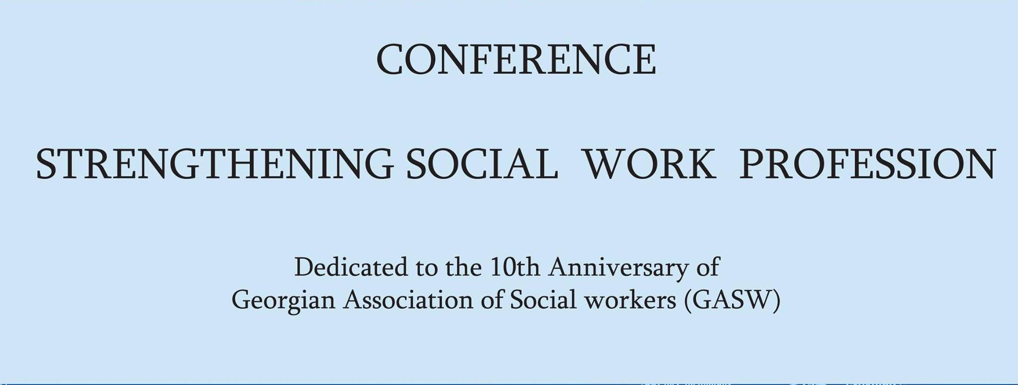
Thank You for Attention!

