Slide 1
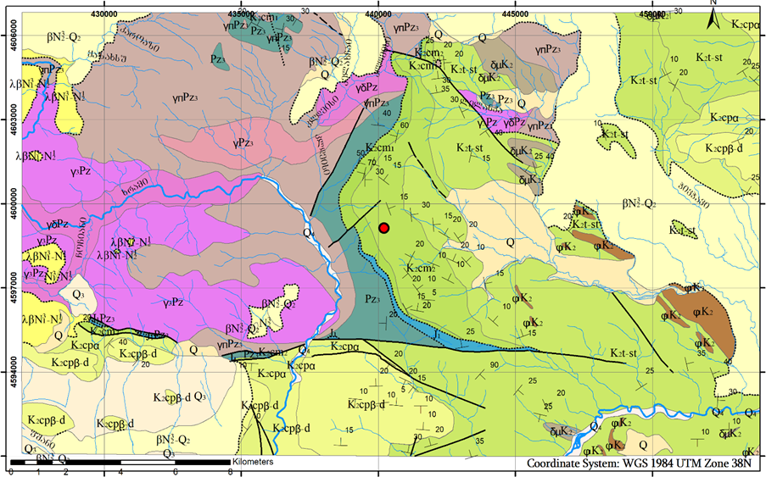
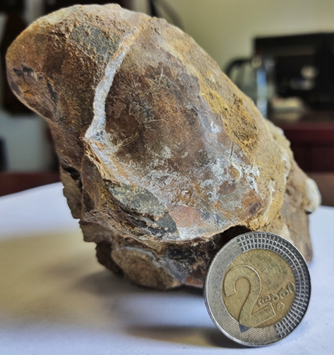
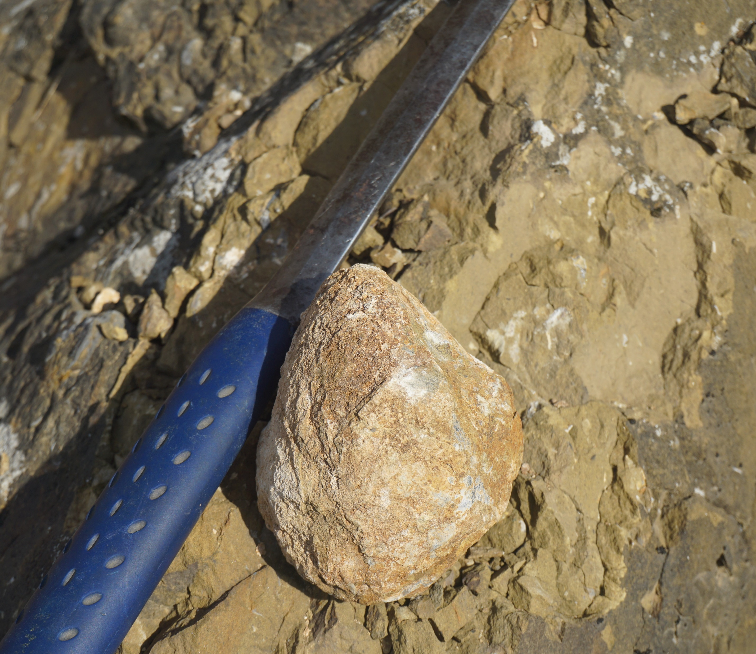
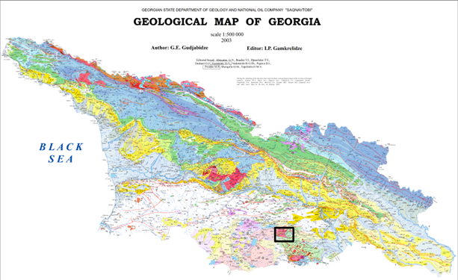
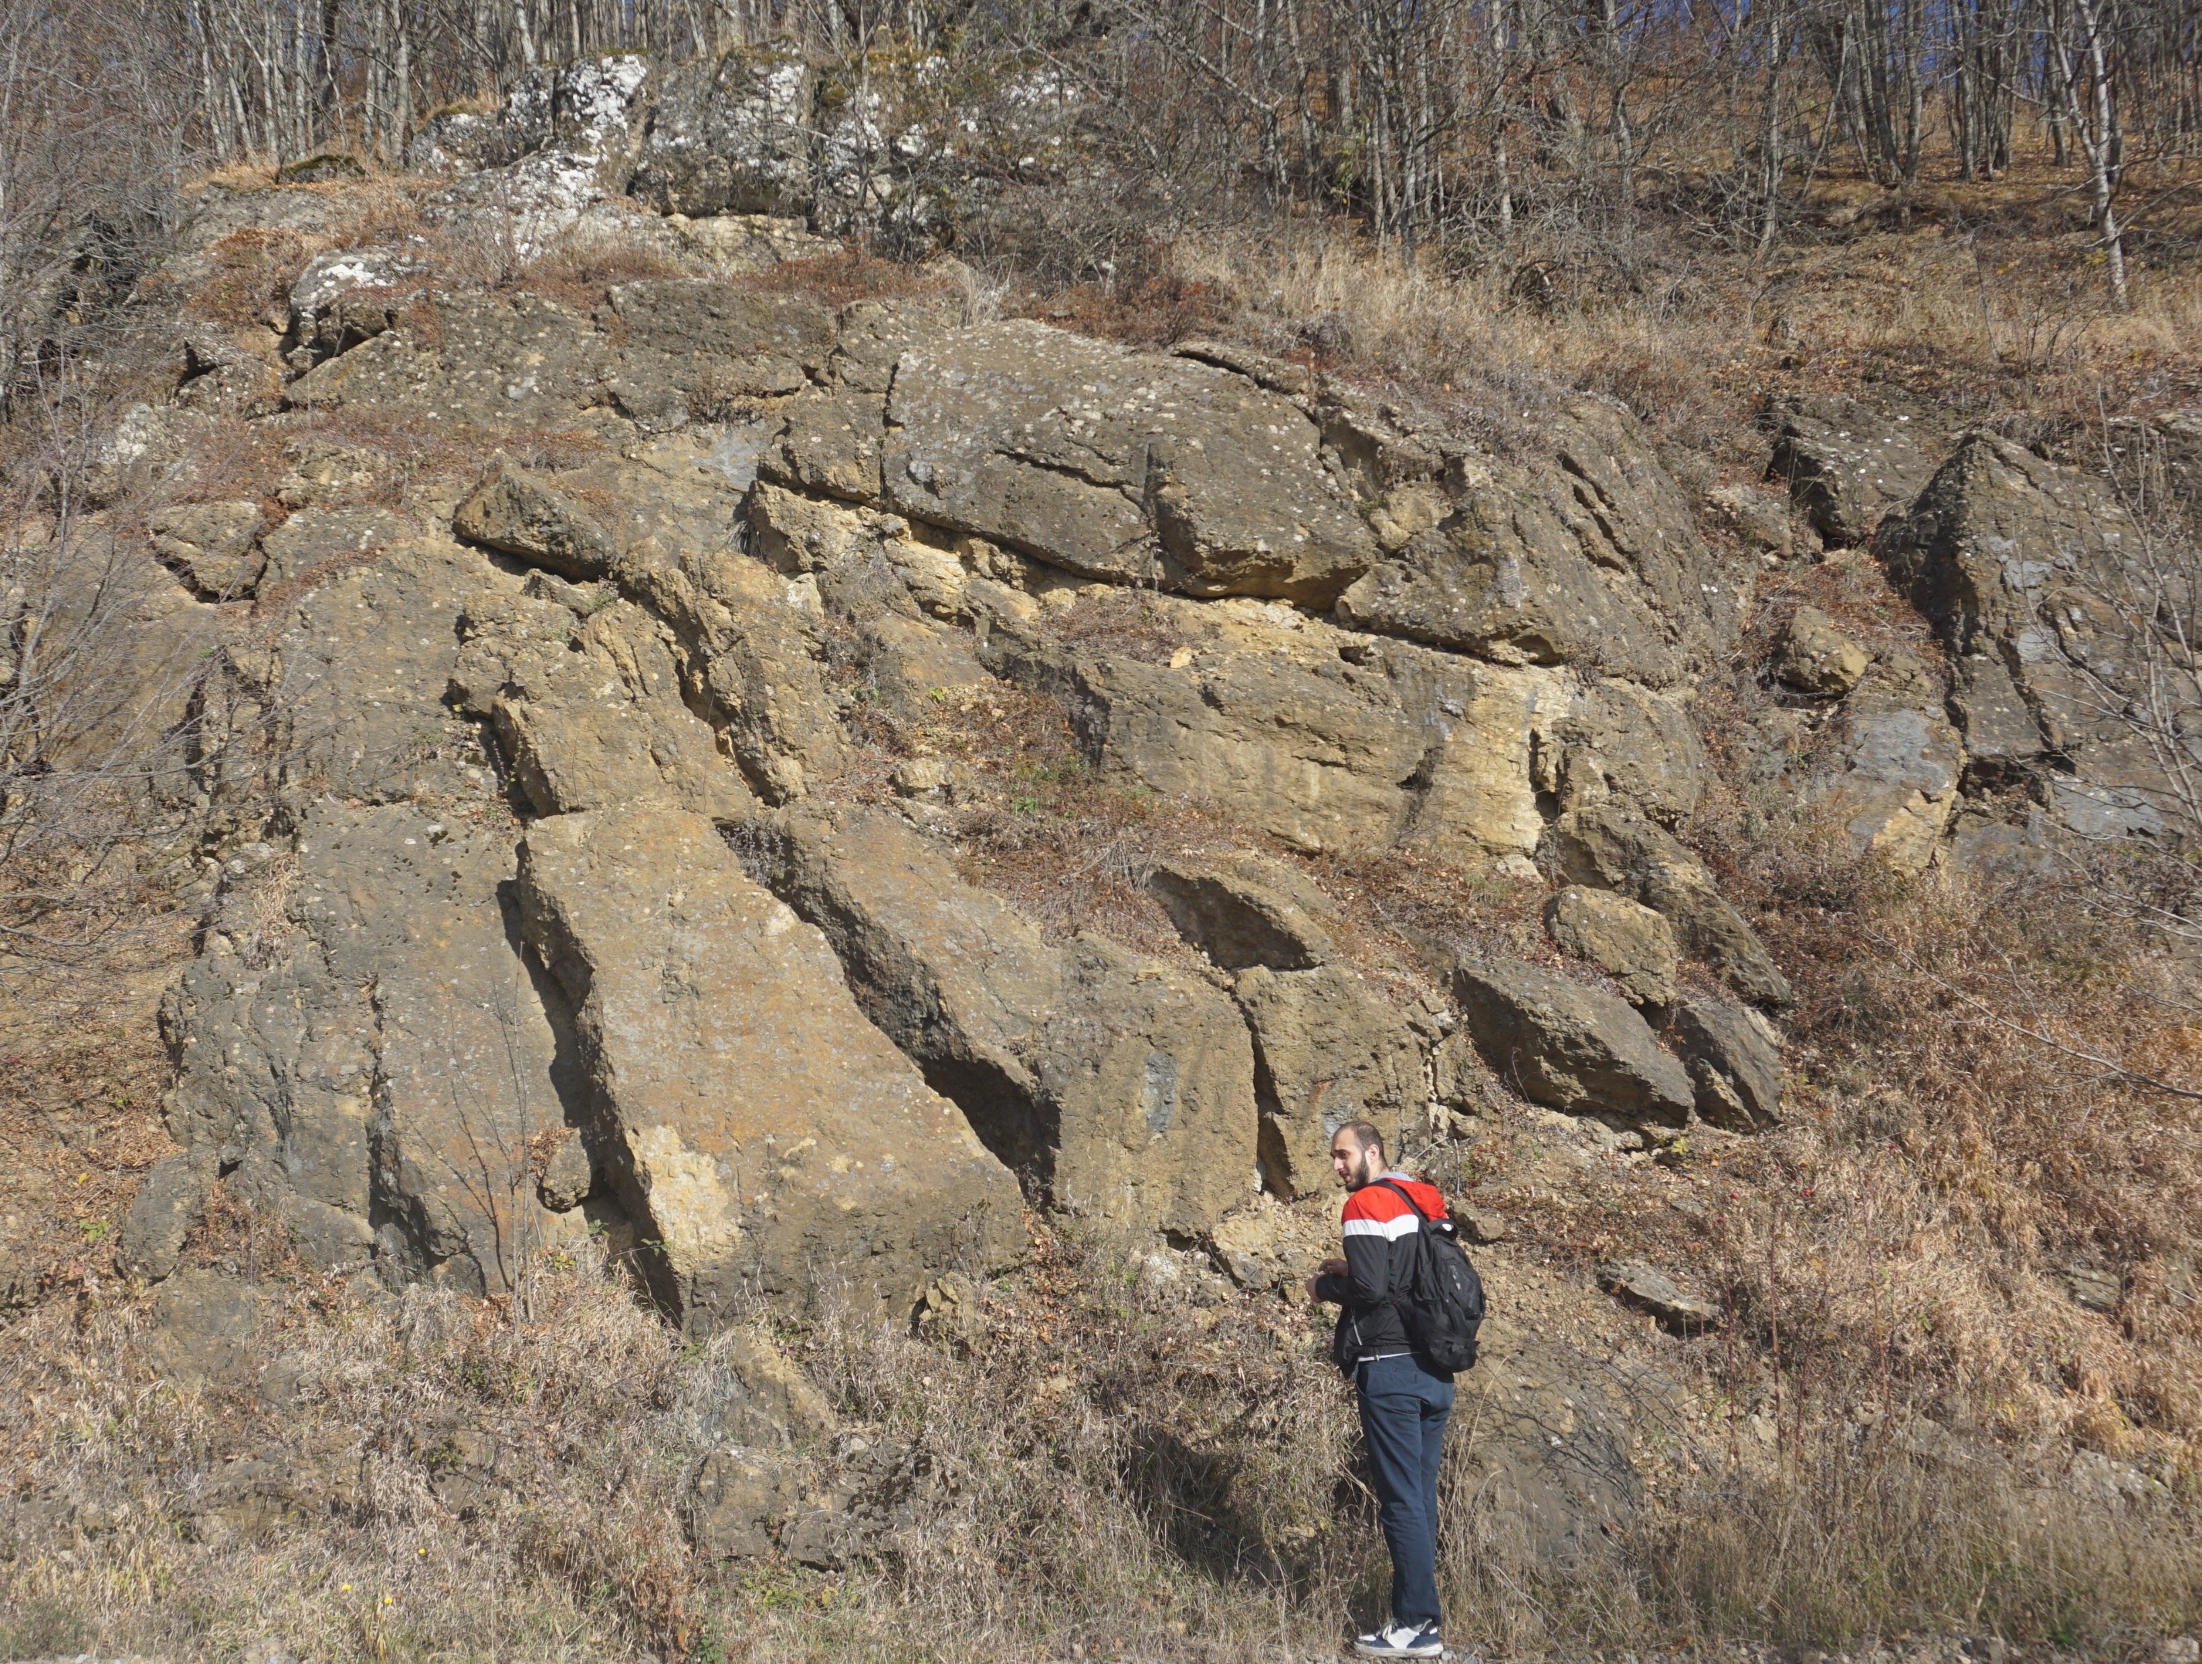
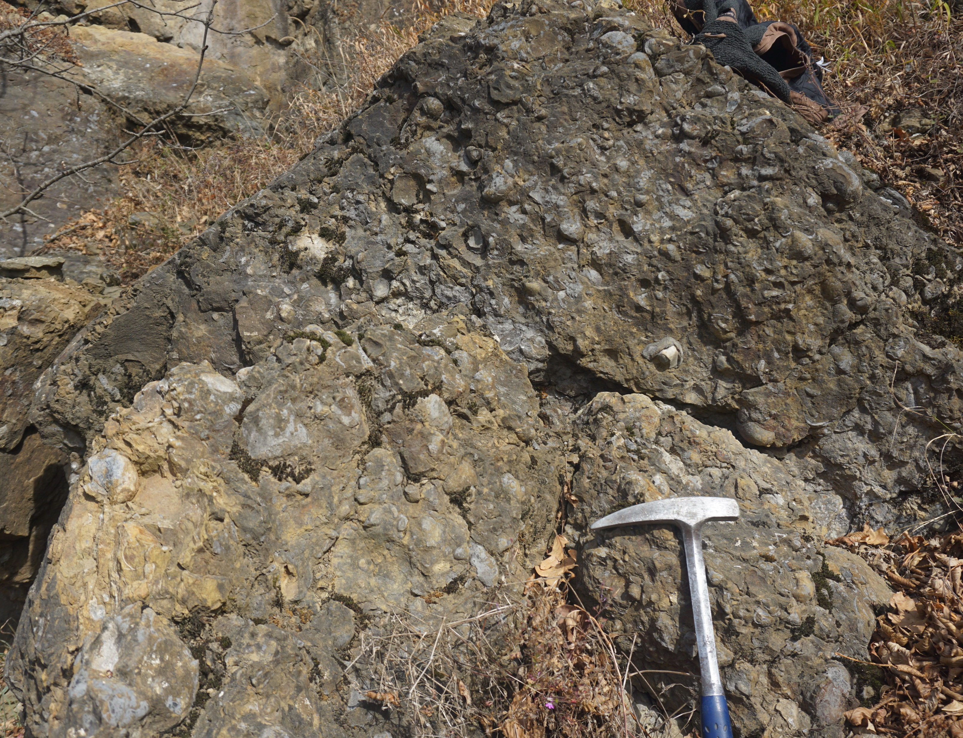
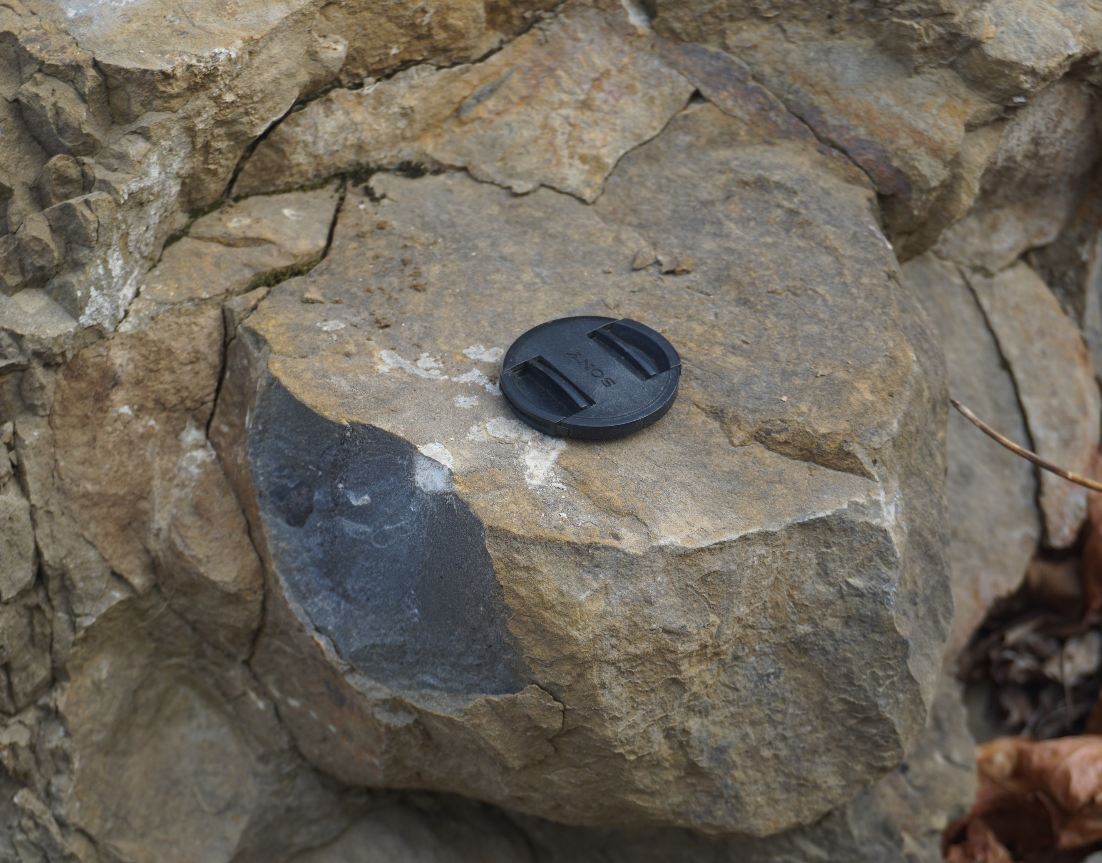
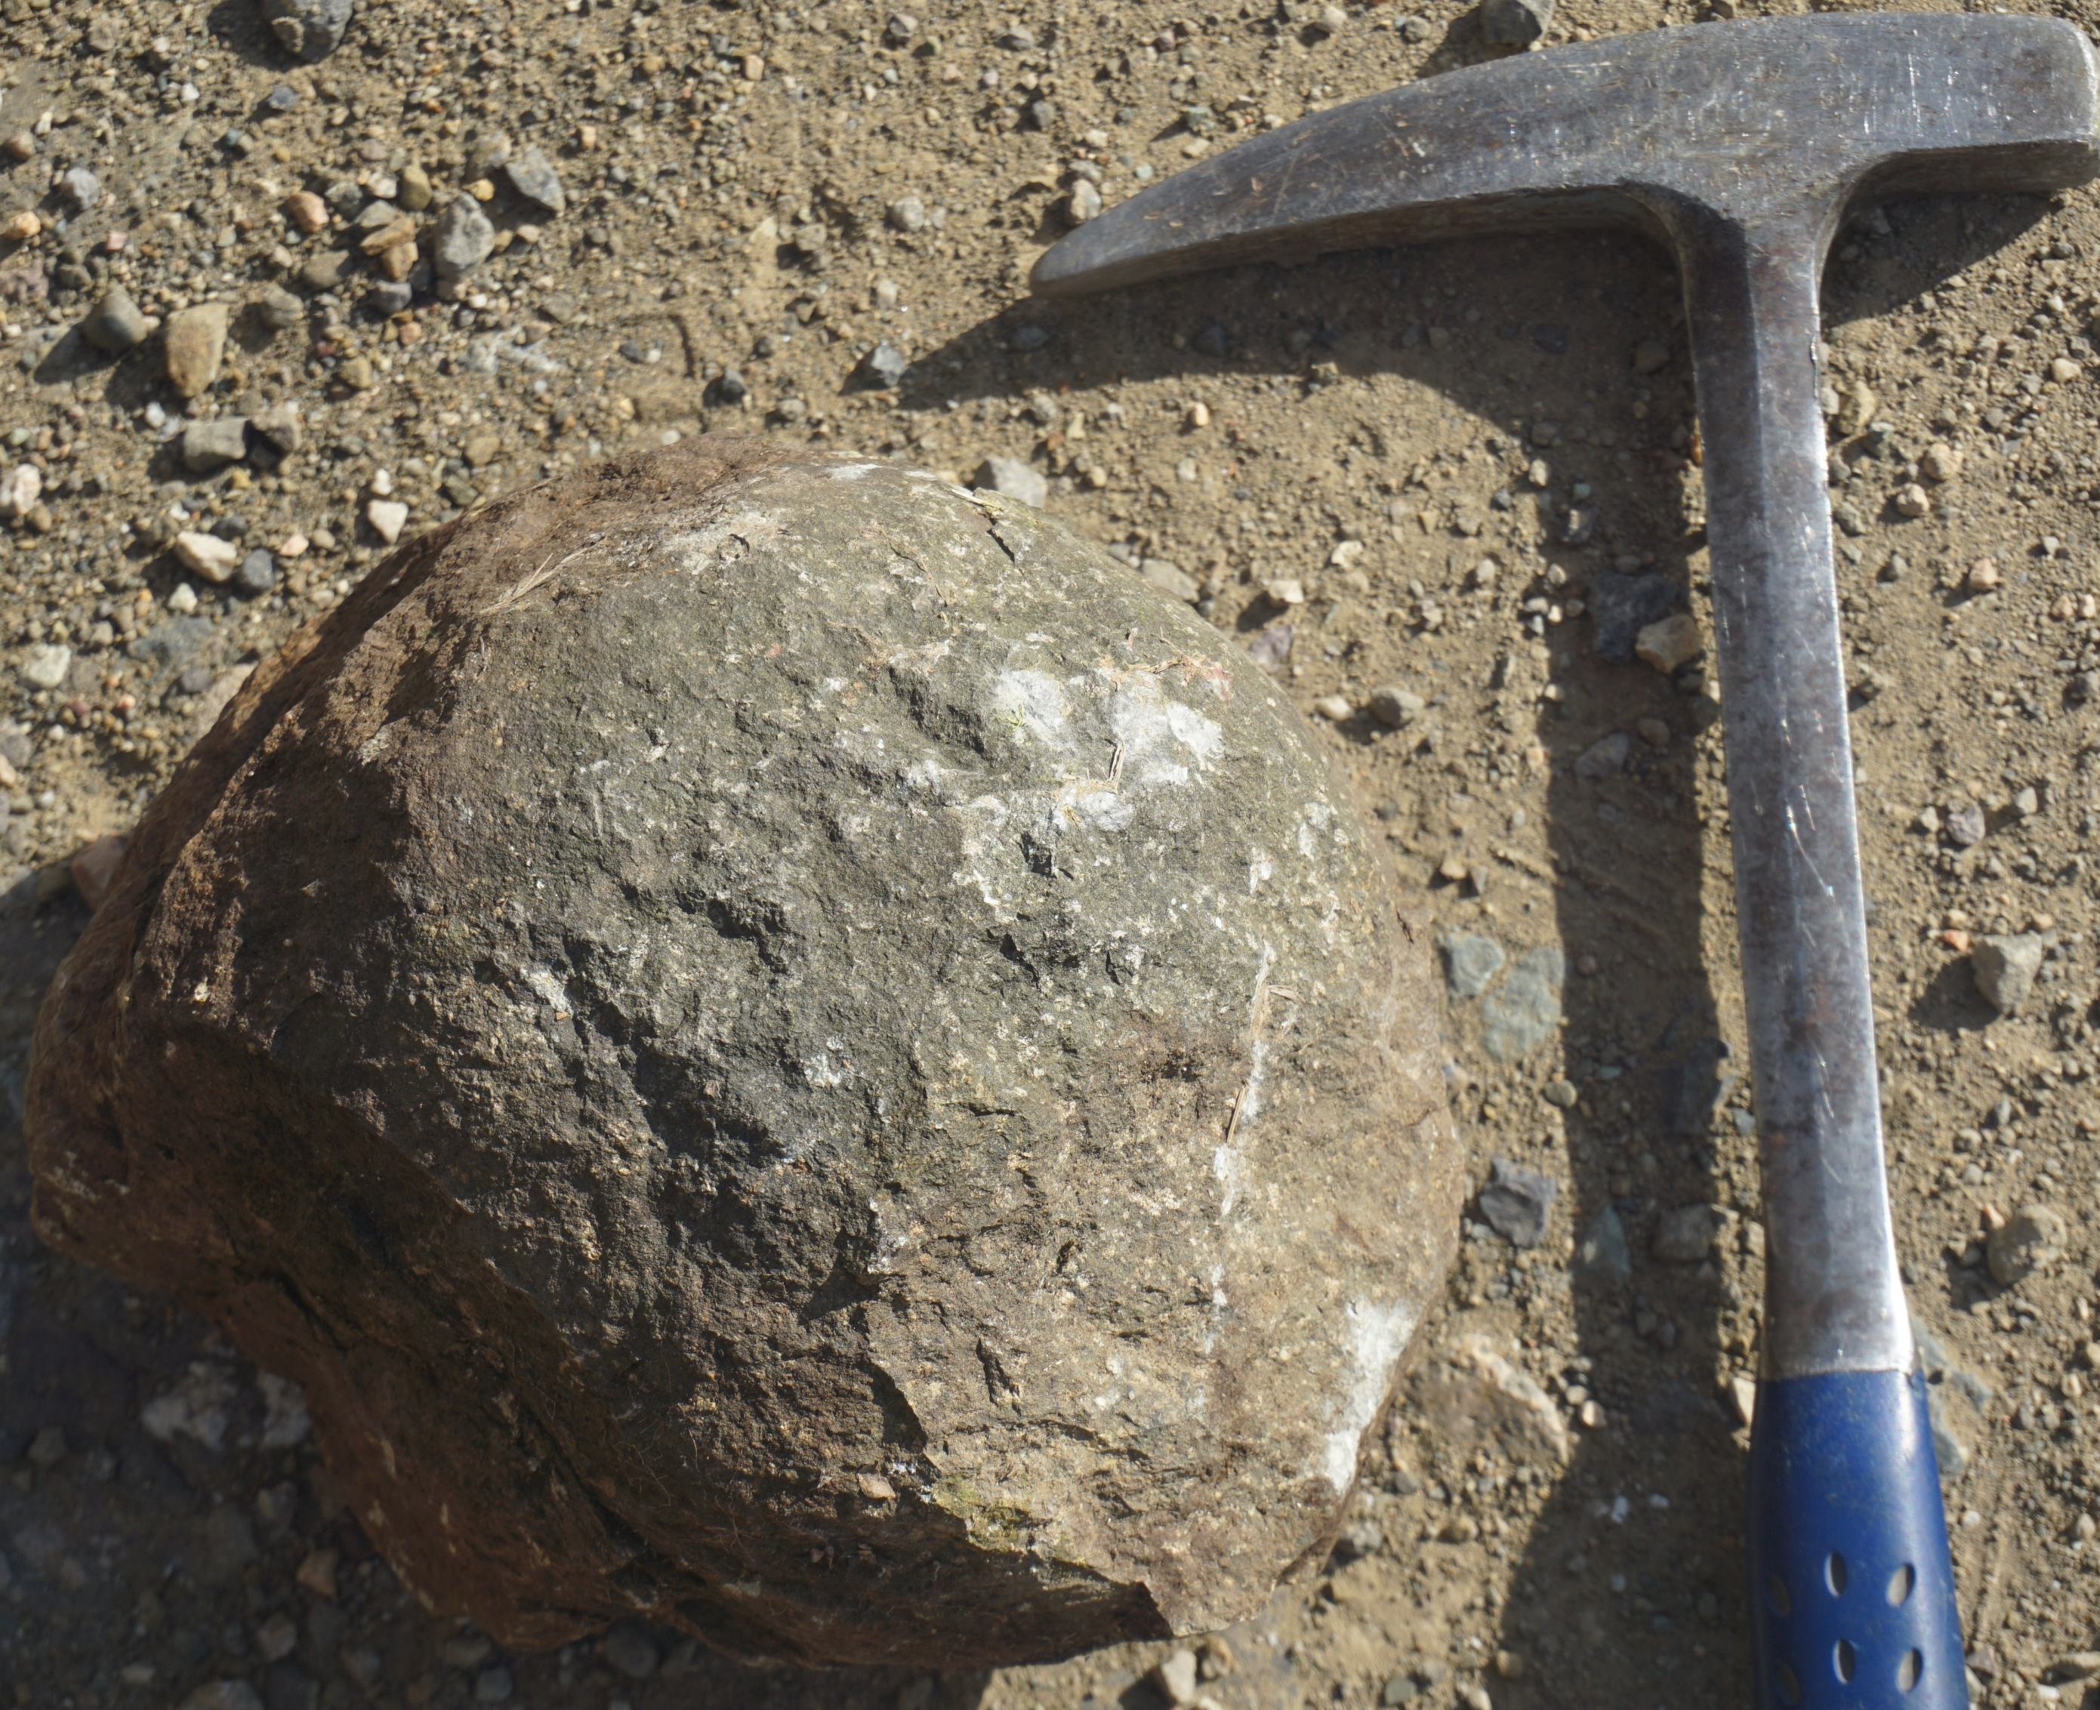
1049
Mass Burial site of the Gryphaeas in Upper Cretaceous sedimentary cover of the Khrami massif, Lesser Caucasus, Georgia
Irakli Gamkrelidze (1), Avtandil Okrostsvaridze (2), Mevlud Sharikadze (3) Daniel Tormey (4), Giorgi Boichenko (2), Salome Gogoladze (2), Rabi Gabrielashvili (2) (1) Tbilisi State University, Al. Janelidze Institute of Geology, Georgia; (2) Ilia State University, Institute of Earth Sciences, Georgia;
(3) Georgian Technical University, Faculty of Geology and Mines, Georgia; (4) Catalyst Environmental Solutions, Santa Monica, USA
corresponding author: salome.gogoladze@iliauni.edu.ge
Introduction / Research Motivation
Earth’s globally significant geological heritage recognized by UNESCO as a scientific-educational, environmental protection and economical areas. Such areas are protected and promoted through the UNESCO Global Geoparks Network (GGN), which represents advances, and disseminates knowledge in Geodiversity management and other disciplines related to studies in Geo-conservation, Geo-tourism, Geo-education and/or the management and activities of Global Geoparks [1].
Georgia has several sites of outstanding geoheritages with cultural and historical connections that have a high potential of becoming a geoparks.
We consider one of such sites in Georgia to be the Kldeisi Gryphaeas mass burial site, situated in the upper part of the Upper Cretaceous carbonatized sediments on the Khrami massif (Tetritskaro suite) (Fig.1) [2].
The first data on this geoheritage site are discussed in the publication.
Materials and Methods
We studied the Kldeisi Grypheys site in detail. We collected 12 samples of this mollusk and determined their species. We also investigated the genetic type and U-Pb geochronology of the Kldeisi submarine volcano. Major and trace elements geochemical analyses were conducted using LA-ICPMS at the MSALABS laboratory in Canada.
Kldeisi Gryphaeas mass burial site
Aknowledgement
•This research was supported by the Shota Rustaveli National Science Foundation of Georgia (SRNSFG) [grant #FR-21-10905];
• This research was supported by the Institute of Earth Sciences and National Seismic Monitoring Centre of Georgia.
Results
Paleontological research has shown that the fossilized mollusks are identified as Gryphaeas and belong to the class of Bivalvia in the Gryphaeidae family (Fig. 3). They are shallow-water, warm-water mollusks, and they existed from the Triassic to the middle Paleogene period, but are mostly restricted to the Triassic and Jurassic. It should be noted that this mollusk is known as 'devil's toenails’ [4].
The Kldeisi site volcanic layer consists of dark-colored, massive, homogeneous rocks interspersed with calcite veins. A geochemical study of these rocks showed that they were the product of a basaltic magma but were enriched with CaO.
In this ash layer, the SiO2 content ranges from 30 to 47%, Al2O3 from 4.7 to 8.0%, MgO from 7.5 to 11.5%, FeO from 4.15 to 6.75%, Na2O from 0.86 to 1.59%, K2O from 0.54 to 1.8%, and CaO content ranges from 22 to 36%. This combination of chemical elements [Ca > Mg > Fe > (Na + K)] is characteristic of carbonate magmas rather than silicate ones [6].
Conclusions
The SiO2 content of the volcanic formation ranges from 30 to 47%, and the CaO content ranges from 22 to 36%. In terms of trace element geochemistry, this volcanic layer is closely related to the intra-plate mid-ocean ridge basalt (MORB).
We believe that the Kldeisi Gryphaea exposure is unique due to the preservation of this colony in its primi-tive form, attributed to volcanic activity. Consequently, it offers the best-case scenario of active geological processes and biosphere interaction.
We firmly believe that the Kldeisi mass burial outcrop of the Gryphaeas is a significant geoheritage and educational site and, as a result, the foremost geotourist attraction.
References
[1] Casadevall, T. J., Tormey, D., and Roberts, J. World Heritage Volcanoes: Classification, gap analysis, and recommendations for future listings. Gland, Switzerland: IUCN, 68p. (2019).
[2] Gamkrelidze, I., Okrostsvaridze, A., Koiava, K., Maisadze, F. Geotourism Potential of Georgia, the Caucasus. Springer, 140 p. (2020).
[3] Gamkrelidze, I., Okrostsvaridze, A., and Maisadze, F., and Boichenko, G. Main Features of Geological Structure and Geotour-ism Potential of Georgia, the Caucasus. Modern Environmental Science and Engineering, 5 (5). pp. 422-442. ISSN 2333-2581) (2019).
[4] Tsagareli, A. L. Upper Cretaceous fauna of Georgia. Monograph, Tbilisi, 345 p (1954). (in Russian).
[5] Duff, j. My Favorite Fossil: The Extinct Oyster Gryphaea (AKA Devil’s Toenails). https://biologos.org.
[6] Niu, Y., Wilson, M., Humphreys, E. R., O'Hara, M. J. The Origin of Intra-plate Ocean Island Basalts (OIB): the Lid Effect and its Geodynamic Implications". Journal of Petrology. 52 (7–8): 1443–1468 (2011).
The Pachydiscus neubergicus (Hauer) and Hauericeras sulcatum (Kner) fauna, dated to the Maastrichtian, is found in this sequence (Fig.2). The exposed part is approximately 50 meters in length, with an average thickness of about 5 meters. Itis intersected in the central part by a roughly 1.5 meter-thick gabbroic subvolcanic body and is covered with a approximately 2 meter-thick volcanic layer of basalts with high
carbonate content (Fig. 3). This layer, in turn, is covered with a deciduous forest.
Fig. 1 the Khrami Massif, the mass burial site of the village Kldeisi. Geological map of Georgia 1:500 000 (Gujabidze et. al.)
Fig. 2 The Gryphaea fossilized mollusk (7X5 cm) of Kldeisi site.
a
b
Fragments of the Kldeisi Gryphaeas mass burial site: a - blocks of rocks built by Gryphaeas and b - close-up of Gryphaeas exposed.
Fig. 3 Pillow basalts overlying the Gryphaeas burial section.

