Slide 1
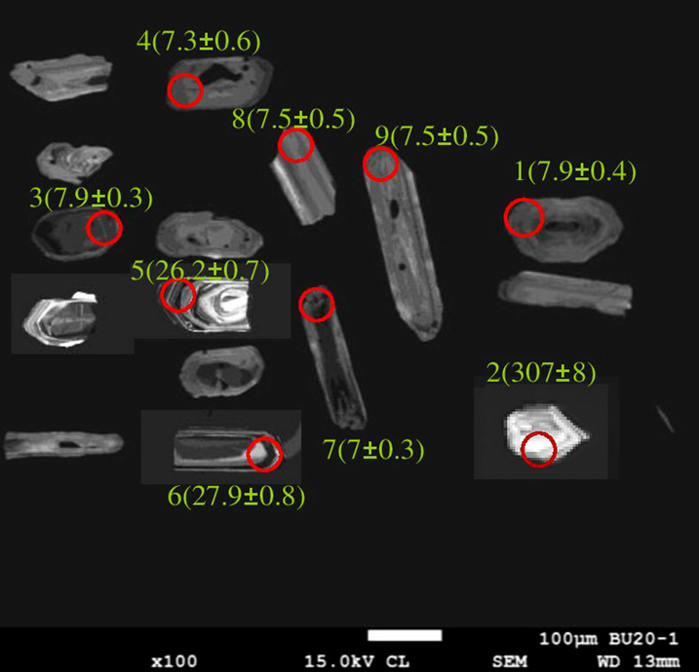
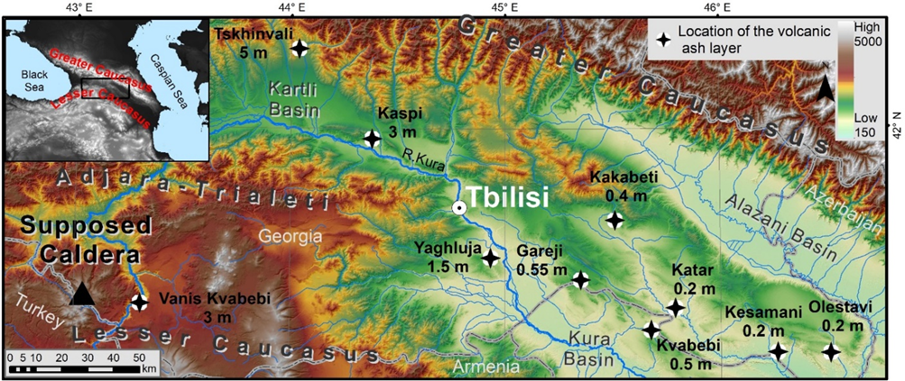
10 47
Determination of Volcanic Ash Layers Source of Easter Caucasus Neogene Basin: Evidence from Zircon U-Pb Geochronology and Geochemistry
Avtandil Okrostsvaridze(1), Yuan-His Lee(2), Mehmet Keskin(4), Daniel Tormay(3), Giorgi Boichenko(1), Salome Gogoladze (1), Rabi Gabrielashvili (1), Mirian Makadze (5)
(1) Ilia State University, Institute of Earth Sciences and National Seismic Monitoring Centre, Georgia, (2) National Chung-Cheng University, Taiwan, (3) Catalyst Environmental Solutions, USA (4) Istanbul Technical University, Turkey, (5) Tbilisi State University, Georgia
Introduction / Research Motivation
U-Pb geochronology and geochemistry of detrital zircons can provide valuable constraints to geological processes and source areas. [1]
Zircon isotopic dating and whole rock geochemistry together provide reliable arguments for correlating eruptive centers and deposition areas of the ash and flows. [3]
Terrigenous ash and sediment deposits in the Neogene basins of the eastern Caucasus intermountain regions contain volcanic ash layers of various thicknesses and compositions. [4]
The main source of volcanic ash layers is considered to be caldera-forming eruptions (Gumbati eruption) during which Kura ignimbrite flow was generated. This study provides firm geochronological and geochemical constraints [5,6]
Acknowledgement
This research was supported by the Shota Rustaveli National Science Foundation of Georgia (SRNSFG) [grant #FR-21-10905]
This research was supported by Institute of Earth Sciences and National Seismic Monitoring Centre
Materials and Methods
A suite of 12 ash samples (~3.5 kg each) were collected from the Neogene volcanic ash layers of the Eastern Caucasus intermountain depression. The U-Pb zircon geochronology was conducted at the Department of Earth and Environmental Sciences, National Chung-Cheng University, Taiwan, via laser ablation inductively coupled plasma mass spectrometry equipped with an Agilent 7500s quadrupole and a New Wave UP213 laser ablation system. All twelve volcanic ash layers samples were also analyzed for whole-rock geochemical compositions by a multi-element ICP-AES/MS in MSALABS laboratory, Canada.
Discussion and Conclusions
The U-Pb geochronology, trace element geochemistry, orientation of the distribution of volcanic ash layer thickness, and zircon morphology of young zircons support the hypothesis that these layers had a common source with the ignimbrites of the Samtskhe-Javakheti volcanic highland. These ignimbrites include the Kura ignimbrite flow (~7.5 Ma)
Based on the distribution of the volcanic ash layers and the analysis of the structure and scale of the Kura ignimbrite flow, both the ignimbrites and volcanic ash layers were deposited from a large collapse caldera-forming eruption. The youngest andesitic flow of this caldera structure has been dated as ~6.5 Ma. This caldera also extends to the northeastern territory of Turkey (NE part of the Kars Plateau).
References
[1] Cawood PA, Hawkesworth, CJ, Dhuime B.: ‘’Detrital zircon record and tectonic setting’’. Geology 40(10):875–878. (2012).
[2] Dacre HF, Grant ALM, Harvey NJ, Thomson DJ, Webster HN, Marenco F.: Volcanic ash layer depth:Processes and mechanisms. Geophys Res Lett 42:637-645. (2015).
[3] Willcock M, Cas RAF, Giordano G, Morelli G.: The eruption, pyroclastic flow behavior, and caldera in-filling processes of the extremely large volume (&gt; 1290 km(3)), intra- to extra-caldera, Permian Ora (Ignimbrite) Formation, Southern Alps, Italy, Journal of Volcanology and Geothermal Research 265:102-126. (2013).
[4] Skhirtladze NI.: On the use of volcanic ashes for dating volcanic formation. XXII International Geological Congress, 14–22 December, New Delhi, p 207–214 (1964)
[5] Okrostsvaridze A, Gagnidze N, Bobrova I, Skhirtladze I.: Late Miocene Volcanic Ash Layers of the Intermountain Depression of the Eastern Caucasus: the Products of the Megacaldera Eruption? In Proceeding of UNESCO IGCP pr. #610 meeting. Palermo, Italy, pp 148-152 (2017).
[6] Okrostsvaridze A, Chung SL, Chang YH, Skhirtladze I.: Geology and Zircon U-Pb Geochronology of the Mtkvari Pyroclastic Flow and Evaluation of Destructive Processes affecting Vardzia rock-cut City. Quaternary International540(25):137-145. (2019).
9 zircons were dated. The weighted mean U-Pb age of 6 zircons corresponds to 7.51±0.2 Ma (MSWD=0.54). These data are in complete geochronological correlation with the Kura ignimbrites zircons of the Samtskhe-Javakheti volcanic highland [6].
Seven grains of the Upper Miocene zircons were found in the ash layer of Yaghluja outcrop whose U-Pb isotopic age corresponds to 6.7-7.7 Ma.
We conducted whole-rock geochemical analyses of major and trace elements in 12 samples. The trace element characteristics show that the ash layers and the Kura ignimbrites were derived from the same magma chamber. Zircons, showed significant geochemical similarity in their U and Th contents. Specifically, in the Kura ignimbrite flow, U content ranges from 314-574 ppm, and Th content ranges from 200-628 ppm. In the zircons of the volcanic ash layers these contents range from 248-462 ppm and 174-585 ppm respectively.
Fig. 2 LA-ICP-MS Cathodoluminescence images of the dated zircons of the Bertubani volcanic ash layer.
Results
From the Eastern Caucasus Neogene intermountain basin volcanic ash layer samples, many of the 250 zircon grains were detrital.
Fig. 1. Distribution of the Upper Miocene volcanic ash layers outcrops in the Eastern Caucasus intermountain Neogene basin. Black color cross indicate the location of exposure, and meters - its thickness.
The 0.5 m thick outcrop of volcanic ash layers near the Berthubani is mainly composed of fine-grained plagioclase, limonite, hornblende, and volcanic glass.
Fig. 3 a closeup photo of Yaghluja volcanic ash layer (white colour).

